Slide 1
DIAGNOSTIC & BASHIC CALCULATOR TEAM MEMBERS Sai kumar Sai Alekhya SUJITHA Varshitha

Slide 2
DIAGNOSTIC:
Problem Statement:
The goal is to analyze phishing emails and the malicious file (layoffs.doc) hosted on the server
Key Issues:
Phishing Emails:
The emails are social engineering attacks designed to entice employees into clicking on a malicious link.
The subject matter (layoffs) is emotionally charged, increasing the likelihood of recipients engaging with the email.
Malicious Document Hosting:
The link in the phishing email points to a domain (diagnostic.htb/layoffs.doc) that previously resolved but now does not.
However, the malicious document is still being hosted on a server. This suggests that the domain's DNS record was removed, but the server remains accessible directly via its IP address

Slide 3
DIAGNOSTIC OVERVIEW
Required Tools:
Breakdown:
Describe how the tools are used for diagnostics and analysis.
OLE Tools: For extracting and analyzing external links.
CyberChef: For decoding and analyzing encoded scripts (e.g., Base64).
PowerShell: For accessing and testing commands.
Include steps for script analysis and highlight any found malicious code.
Remnux: Specialized for Malware Analysis and Reverse Engineering

Slide 4
Set Up
Set Up the Environment
The analysis will be done on REMnux-a Linux distribution for malware analysis-which will guarantee a safe, isolated environment. First, update /etc/hosts to map the domain diagnostic.htb to its IP address for correct DNS resolution.
Verify
Verify the Connection
Use ping or curl commands to test reachability to that domain, to assure the server is reachable. This will ensure that the malicious file can be downloaded safely.
Download
Download the Malicious Document
Use wget to download the document, layoffs.doc, from the given server to your VM in a directory that you have created. Process the document in isolation within the REMnux environment.
Verify
Verify the File
The next step was to verify the type using the file command to confirm the file type without opening it, for instance, a Microsoft Word document, to ensure it remains in a safe state for further analysis.

Slide 5
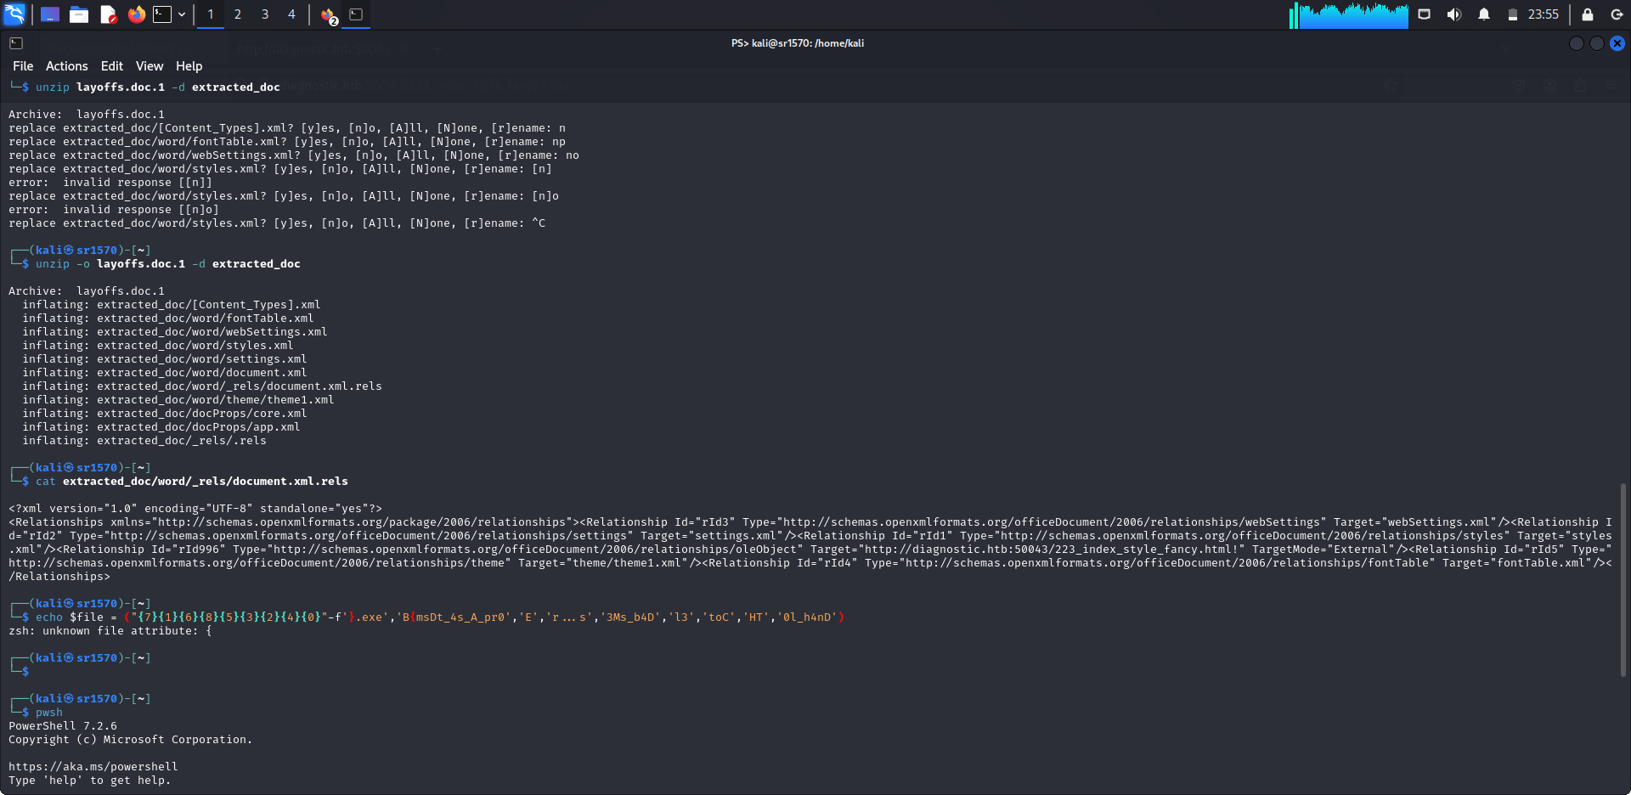
WHY REMNUX? NOT KALI?
Remix is a Linux distribution tailored specifically for malware analysis, digital forensics, and reverse engineering. It comes pre-installed with tools that help dissect, analyze, and understand malicious software, scripts, and binary files.
kali linux is widely used by penetration testers, security researchers, and ethical hackers. it comes with a large set of tools for performing security testing, including vulnerability analysis, web application testing, wireless attacks, and exploitation.

Slide 6
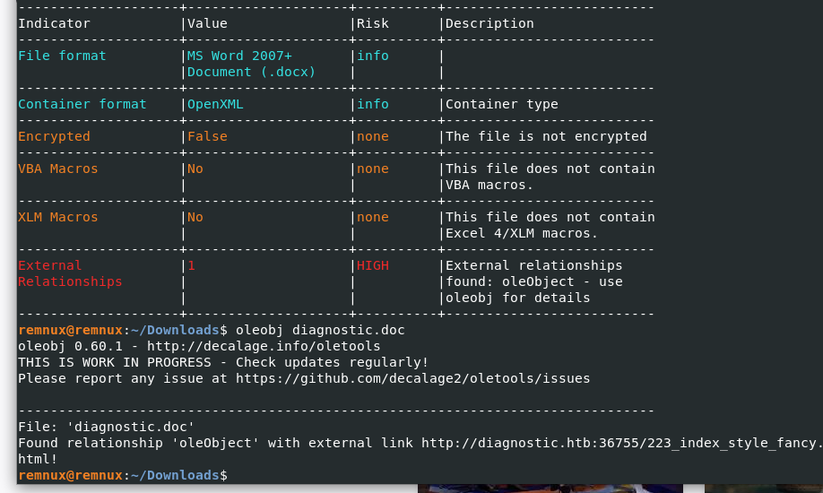
TOOLS
Oletools is a suite of open-source Python tools that are used for analyzing OLE2 (Object Linking and Embedding) files, it is a format used by older Microsoft Office documents (pre-2007) and still used for embedding objects in modern Microsoft Office files (like Word, Excel, etc.). These tools can help extract, analyze, and investigate embedded macros, metadata, and other hidden elements in these types of documents.

Slide 7
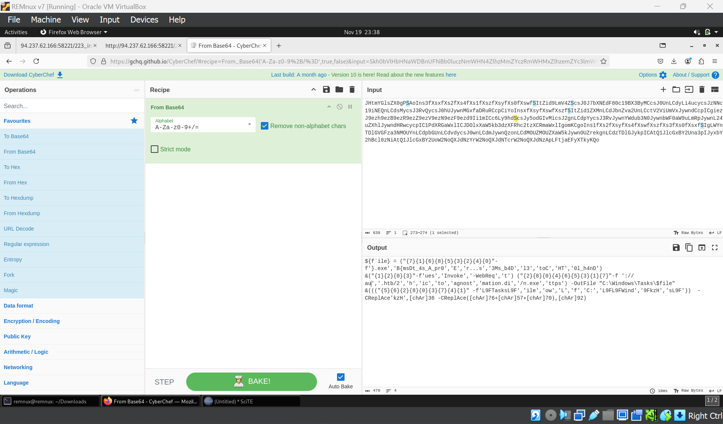
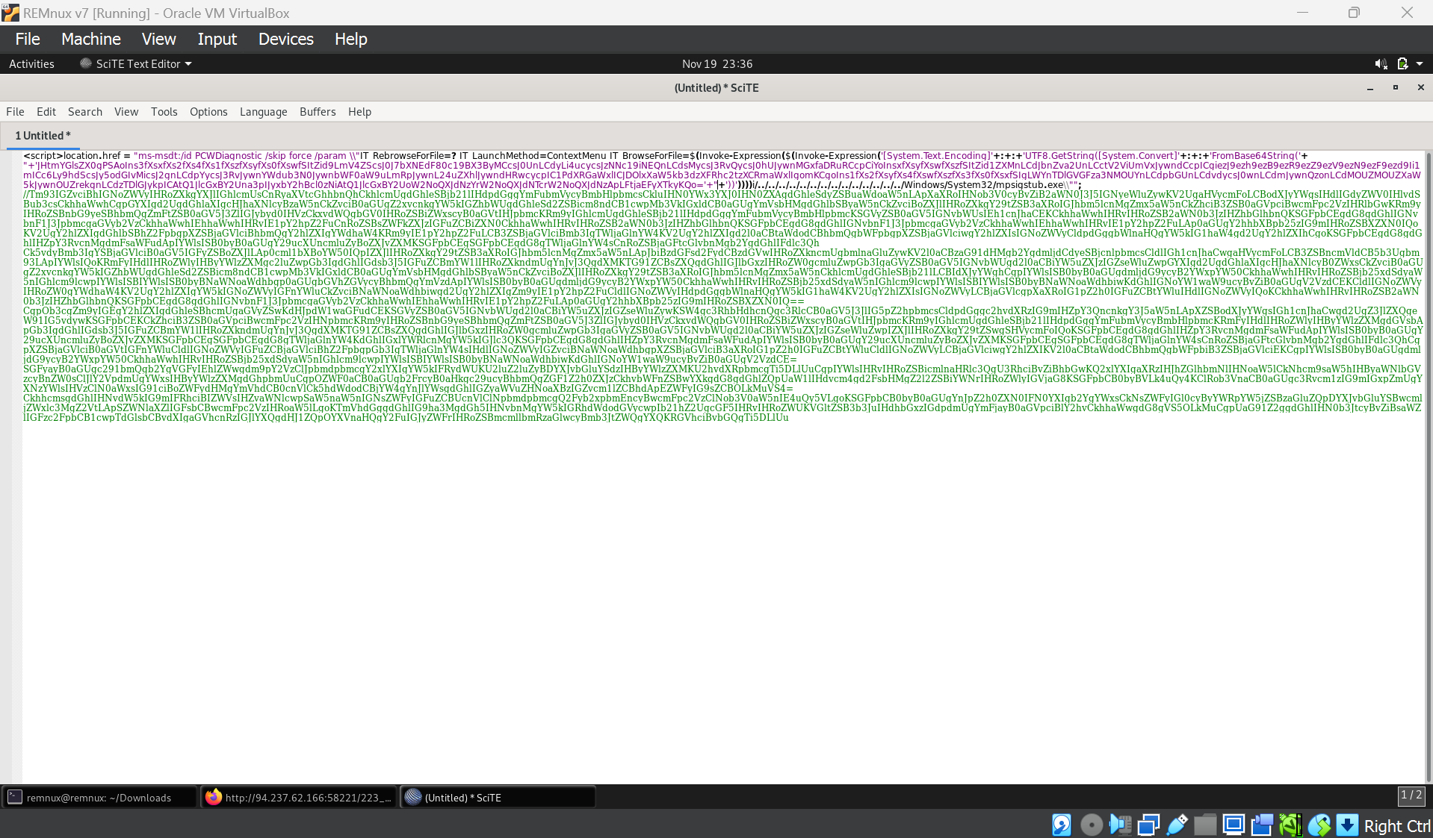
Decoding Obfuscated Data in HTB Diagnostic Challenge:
Blank Link Investigation:
Opened the link, which was blank, and inspected the source code.
Identified Obfuscation:
Found a script with obfuscated characters (char values 34 and 56).
Decoded Using ASCII:
Replaced the character values with corresponding ASCII keys.
Base64 Decoding:
Used CyberChef to decode the resulting Base64 string.
CyberChef can be a valuable tool for decoding and analyzing various types of data, especially when dealing with obfuscation, encoding, or encrypted information found in documents, scripts, or other data formats

Slide 8
HTB Diagnostic Challenge - Final Steps
Decoded Script:
After decoding the Base64 script using CyberChef, the obfuscated content was revealed.
Key Extraction:
Stored the extracted key in a file for further use.
Flag Retrieval:
By reading the file, the flag was obtained.
Flag Submission:
Successfully submitted the flag in HTB, completing the challenge.

Slide 9
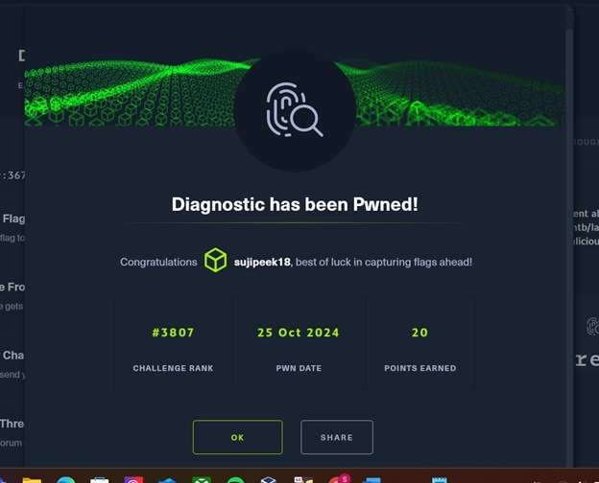
RESULTS

Slide 10
BASHIC CaLCULATOR
Challenge Overview & Initial Setup
Objective:
Solve a calculator challenge that restricts certain characters like $ and backticks to prevent code execution.
Capture the hidden flag.
Initial Setup:
Environment: Kali Linux used for testing and running the setup.
Basic Functionality: The calculator performs simple arithmetic operations (e.g., addition, subtraction).
Key Insight:
Challenge: The calculator filters characters like $ and backticks to prevent code execution.
Problem: Unable to capture the flag with basic operations due to restrictions in place.

Slide 11
Bypass Techniques & Flag Attempt:
Bypassing Restrictions:
Command Substitution: Replace $ with $( ) to execute commands.
Example: $(ls) or $(echo hello).
Semicolons and Logical Operators: Chain commands using ; or &&.
Example: echo hello; ls.
Encoded Commands: Used Base64 or hexadecimal encoding to bypass filters.
Command Injection:
Arithmetic Operations: Explored the use of arithmetic to inject commands (e.g., 1 + 1; ls), but no flag was captured using this method.
Environment Variables: Modified variables like PATH to try and execute hidden commands.
Result:
Mock Flag: A mock flag was captured after applying bypass techniques, but the real flag remains elusive.
Next Steps: Further investigation required to identify the real flag hidden in the challenge.

Slide 12
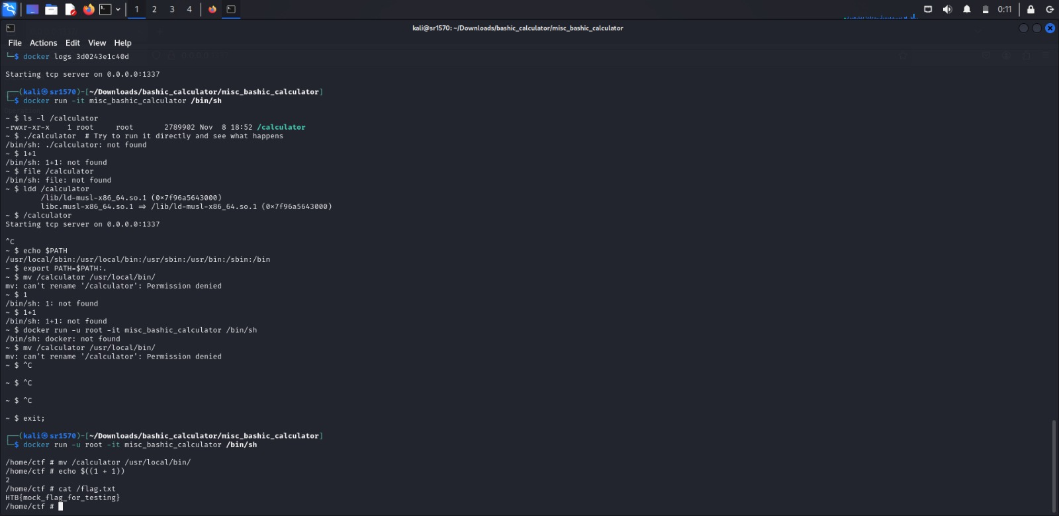
MOCK FLAG

Slide 13
THANK YOU

